Slide 1
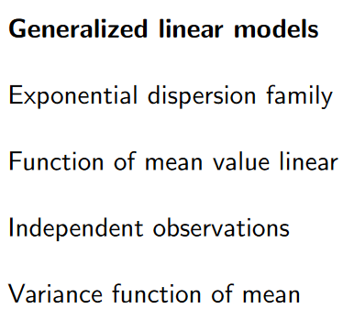
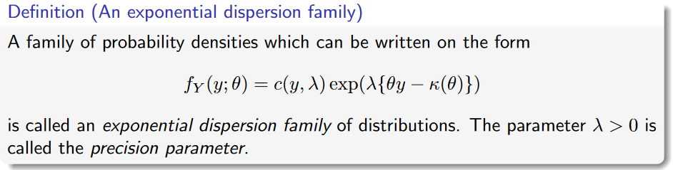

Slide 2
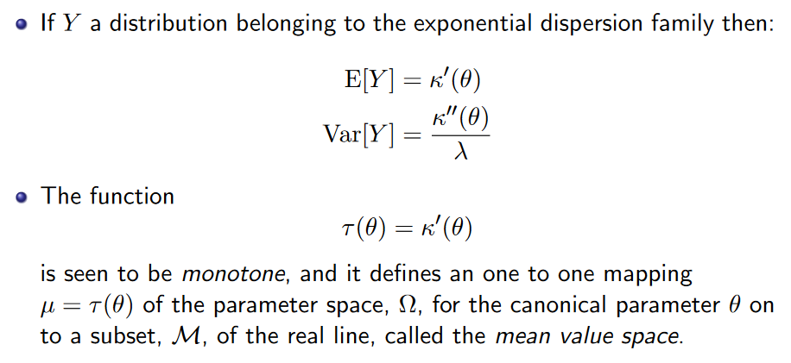
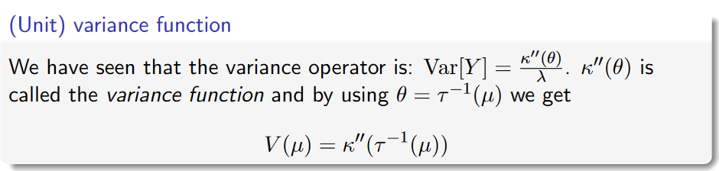

$τ$ is the canonical link:
$$τ^{−1}\left(μ\right)=θ$$
$$τ\left(θ\right)=μ$$

